Slide 1
8/28/2024 Structure Determination
This lecture is intended to help you achieve the following learning objective: Summarize the principles behind the main methods used to determine the structures of biological macromolecules. Compare their relative benefits and drawbacks.
It will be about
General principles of structure determination
The Protein Data Bank
Experimental methods for structure determination
X-ray crystallography
Nuclear magnetic resonance (NMR)
Cryogenic Electron Microscopy (Cryo-EM)
At the end of this lecture, you should be able to answer the following questions:
What are the major ways in which we obtain the structures used for molecular modeling?
What are the relative benefits and drawbacks of each technique?
based on a lecture by Andy Howard (Summer 2021) adapted by Jennifer Sorescu (Spring 2022)

Slide 2
General structure determination principles

Slide 3
What is structure determination?
Determining three-dimensional positions of atoms in a molecular system that are consistent with experimental measurements
Structures do not come from experimental measurements, but are inferred. This means that “experimental” structures are models.
If the positions of some atoms are not justified by the data, they may be omitted.
H atoms
Flexible regions in a protein
Sometimes more than one model is a good fit to the data.
https://journals.plos.org/plosone/article/figure?id=10.1371/journal.pone.0124580.g004

Slide 4

Why determine structure?
Structure-function relationships - knowledge of a structure provides insight into how it works
Identify critical residues for
binding to ligands and proteins
enzyme catalysis
connecting domains
Modeling
Structure-based drug design
Starting point for molecular simulation
Structure prediction
https://www.researchgate.net/publication/323700552_Computer-Aided_Drug_Design_in_Epigenetics

Slide 5
Resolution
Resolution = the size of the smallest observable detail that is discernible in a structural model
High resolution = small #; low resolution = large #
Summarizes the precision of atomic positions
https://www.biorxiv.org/content/10.1101/2022.04.07.487522v1.full

Slide 6
Needed Resolutions are Application-Dependent
For drug design we generally need near-atomic (~1.8Å resolution) so we can tell how the ligand is going to fit into the structure
Alternate conformations or solvent dynamics might need better resolution
For molecular dynamics, we need high resolution if we’re trying to do QM in parts of the structure or if we want to begin the simulation with the atoms precisely located; but if we only want to model big changes, we can make do with 3 Å or even 5 Å resolution
https://www.cambridgemedchemconsulting.com/resources/sbd.php

Slide 7

The Protein Data Bank
https://www.rcsb.org/
8/27/2022

Slide 8
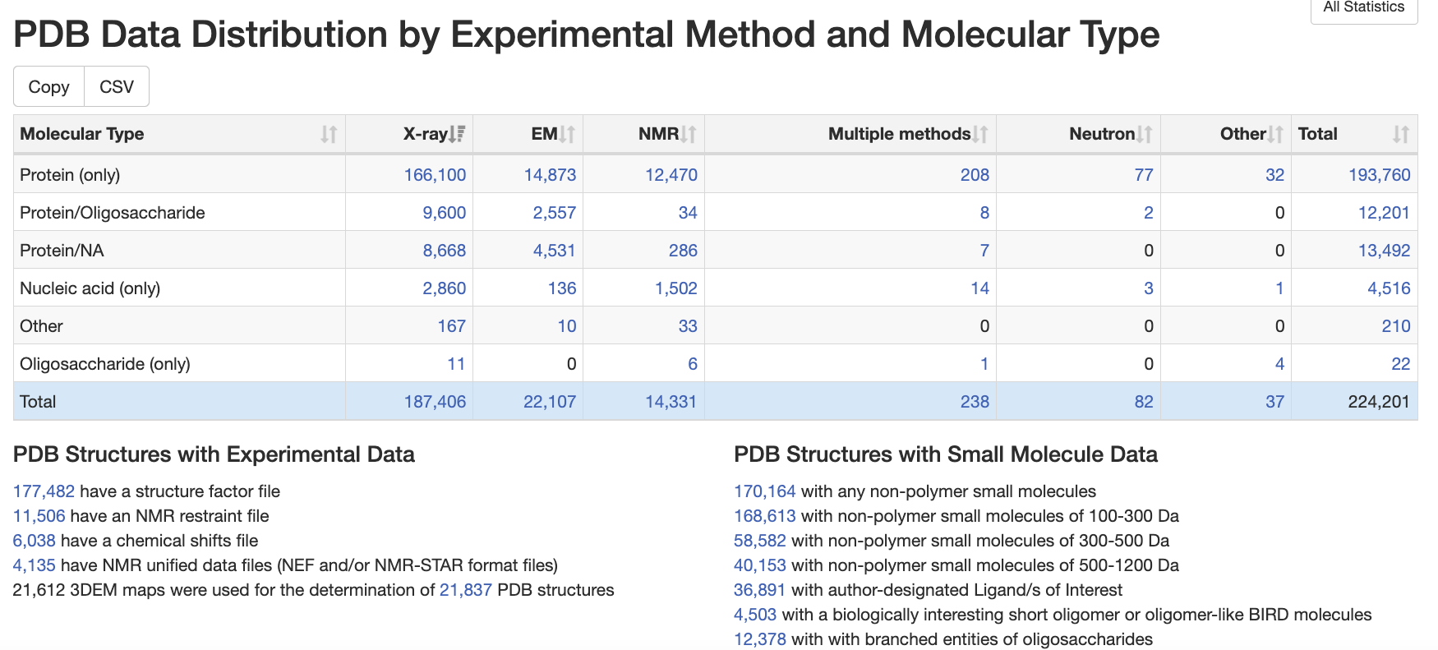
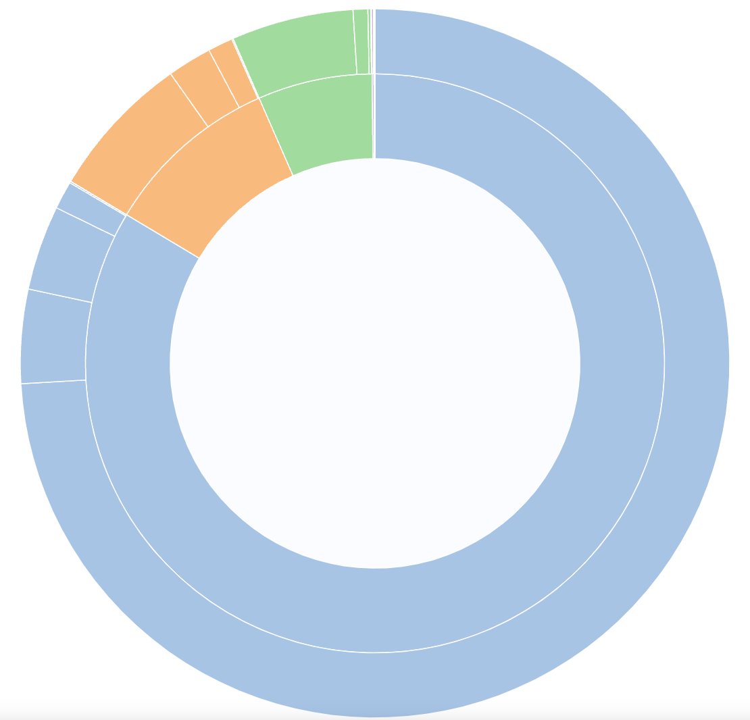
https://www.rcsb.org/
8/27/2024

Slide 9
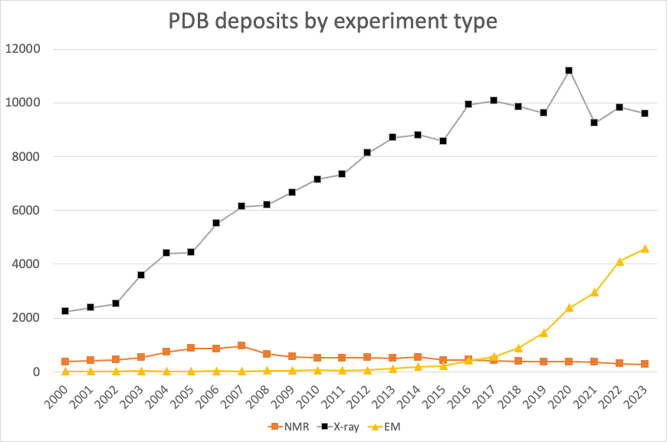
Data from
https://www.rcsb.org/
on 8/27/2024

Slide 10
Experimental methods for structure determination

Slide 11
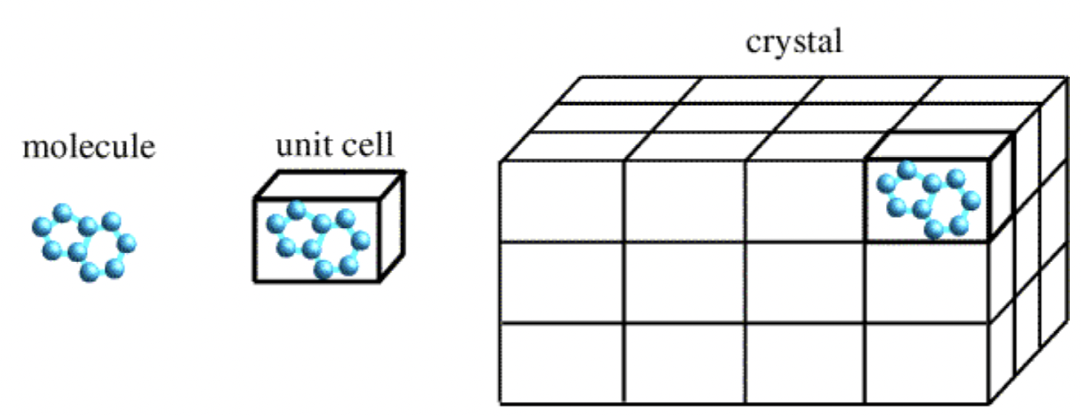
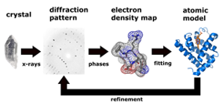
X-ray Crystallography
Crystals
Translationally ordered arrays of molecules
Most solids are crystalline
Distances between atoms and orientations are similar for each unit cell
X-rays are deflected by electrons
A crystal causes interference between X-rays, leading to spots (Bragg reflections)
Atomic model inferred from diffraction patterns at different angles
https://dasher.wustl.edu/bio5325/lectures/lecture-24.pdf

Slide 12
Benefits and Drawbacks
Benefits
High resolution possible
High-throughput facilities, e.g. Advanced Light Source at Argonne National Laboratory
Ordered waters can be observed
Drawbacks
Macromolecule(s) need to be crystallized
Can require specific conditions, e.g. >95% purity
May require special construct
Crystal contacts may impact structure, but
crystalline proteins still have biological activity
contacts have less influence on the interior than surface
Usually, but not always, collected at low temperature
Hydrogen, and thus protonation, usually unavailable
https://www.mdpi.com/1420-3049/25/5/1030/htm#
https://www.umass.edu/microbio/chime/pe_beta/pe/protexpl/xtlcon.htm

Slide 13
Nuclear Magnetic Resonance
uses a large magnet to probe spin properties of atomic nuclei
like other spectroscopies, uses electromagnetic radiation (radio waves) to promote transitions between energy levels
resonant frequency proportional to strength of magnetic field
https://en.wikipedia.org/wiki/Nuclear_magnetic_resonance#/media/File:700_lab_fix.JPG

Slide 14
Nuclear Spin
Like electrons, nuclei have spin
Quantum numbers
I for spin
m for spin in a magnetic field
If the number of protons and neutrons
is even, zero spin
is odd, non-zero spin
If non-zero spin,
nucleus has magnetic moment $μ=γI$, where $γ$ is a gyromagnetic ratio, that depends on the nucleus
Nuclei | Spin | Gyromagetic Ratio (MHz/T) | Natural Abundance (%)
1H | 1/2 | 42.576 | 99.9985
13C | 1/2 | 10.705 | 1.07
31P | 1/2 | 17.235 | 100
27Al | 5/2 | 11.103 | 100
23Na | 3/2 | 11.262 | 100
7Li | 3/2 | 16.546 | 92.41
29Si | 1/2 | -8.465 | 4.68
17O | 5/2 | 5.772 | 0.038
15N | 1/2 | -4.361 | 0.368
The gyromagnetic ratios for several common nuclei
https://chem.libretexts.org/Bookshelves/Physical_and_Theoretical_Chemistry_Textbook_Maps/Supplemental_Modules_(Physical_and_Theoretical_Chemistry)/Spectroscopy/Magnetic_Resonance_Spectroscopies/Nuclear_Magnetic_Resonance/Nuclear_Magnetic_Resonance_II

Slide 15
Nuclear spin in a magnet
Nuclei behave as a tiny bar magnet
without magnetic field, randomly oriented
with strong magnetic field, aligns
with field or (low energy)
against field (high energy)
Figure NMR.1 from https://chem.libretexts.org/Bookshelves/Physical_and_Theoretical_Chemistry_Textbook_Maps/Supplemental_Modules_(Physical_and_Theoretical_Chemistry)/Spectroscopy/Magnetic_Resonance_Spectroscopies/Nuclear_Magnetic_Resonance/Nuclear_Magnetic_Resonance_II
Nuclear energy level is $E=-mℏγB_{O}$
m is magnetic quantum number, e.g. $±\frac{1}{2}$
$ℏ$ is Plank’s constant over $2π$
$γ$ is magnetic moment
Figure NMR.2 The splitting of the degenerate nuclear energy levels under an applied magnetic field.

Slide 16
Spin flip
For a photon to be absorbed, its energy must match the energy gap, $ν=\frac{γB_{o}}{2π}$
Figure NMR.3: Absorption of radio frequency radiation to promote a transition between nuclear energy levels, called a spin flip.
https://chem.libretexts.org/Bookshelves/Physical_and_Theoretical_Chemistry_Textbook_Maps/Supplemental_Modules_(Physical_and_Theoretical_Chemistry)/Spectroscopy/Magnetic_Resonance_Spectroscopies/Nuclear_Magnetic_Resonance/Nuclear_Magnetic_Resonance_II

Slide 17
Shielding
The effect that shielding from electrons has on the splitting of the nuclear energy levels. Electrons impart their own magnetic field which shields the nucleus from the externally applied magnetic field. This effect is greatly exaggerated in this illustration.
https://chem.libretexts.org/Bookshelves/Physical_and_Theoretical_Chemistry_Textbook_Maps/Supplemental_Modules_(Physical_and_Theoretical_Chemistry)/Spectroscopy/Magnetic_Resonance_Spectroscopies/Nuclear_Magnetic_Resonance/Nuclear_Magnetic_Resonance_II

Slide 18
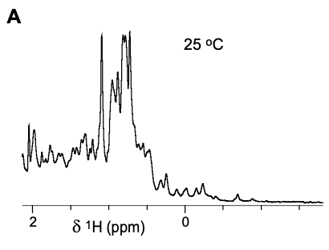
Protein NMR
Peak overlap is an even larger issue with proteins than small molecules!
Methyl region from 1H NMR spectra of SARS-CoV-2 MPro.
Fig 1a of Kantsadi, A. L.; Cattermole, E.; Matsoukas, M.-T.; Spyroulias, G. A.; Vakonakis, I. A COVID Moonshot: Assessment of Ligand Binding to the SARS-CoV-2 Main Protease by Saturation Transfer Difference NMR Spectroscopy; preprint; Biochemistry, 2020. https://doi.org/10.1101/2020.06.17.156679.
NMR is performed in multiple dimensions
2D correlation spectrum of SARS-CoV-2 envelope transmembrane
(1)
Fig 1c of Mandala, V. S.; McKay, M. J.; Shcherbakov, A. A.; Dregni, A. J.; Kolocouris, A.; Hong, M. Structure and Drug Binding of the SARS-CoV-2 Envelope Protein Transmembrane Domain in Lipid Bilayers. Nat Struct Mol Biol 2020, 27 (12), 1202–1208. https://doi.org/10.1038/s41594-020-00536-8.

Slide 19
Protein NMR structures
Sample is irradiated in pulse sequences, which can probe magnetization transferred through
bonds - for assigning chemical shifts to nuclei
space - for distance restraints
Distance restraints are used to build protein models
Ten lowest-energy structures of the SARS-CoV-2 envelope protein’s transmembrane domain
(1)
Fig 3a of Mandala, V. S.; McKay, M. J.; Shcherbakov, A. A.; Dregni, A. J.; Kolocouris, A.; Hong, M. Structure and Drug Binding of the SARS-CoV-2 Envelope Protein Transmembrane Domain in Lipid Bilayers. Nat Struct Mol Biol 2020, 27 (12), 1202–1208. https://doi.org/10.1038/s41594-020-00536-8.

Slide 20
Benefits and Drawbacks of NMR
Benefits
conditions mostly resemble natural surroundings of biological molecules
dynamics in various timescales spanning from picoseconds to days
hydrogen observable
Drawbacks
peak overlap makes determination of larger structures untenable, but recent advances mean proteins (complexes) beyond 100 kDa are within our reach
instrumentation and maintenance expensive and no government-funded facilities
Both: NMR provides ensembles, which may reflect heterogeneity or simply lack of knowledge
Permi, P. Bioanalytical NMR Spectroscopy. In Handbook of Spectroscopy; John Wiley & Sons, Ltd, 2014; pp 1079–1114. https://doi.org/10.1002/9783527654703.ch28

Slide 21
Review Questions
What is required for a nucleus to have an NMR signal?
How is peak overlap addressed in protein NMR?

Slide 22
Cryogenic Electron Microscopy (Cryo-EM)
illuminates samples with beams of electrons
resolution limited by electron wavelength
Transmission Electron Microscope
https://cryoem.slac.stanford.edu/what-is-cryo-em

Slide 23
Cryo-EM history
EM long used for biological imaging at organelle scale (>10 nm)
Before 1985, ~0.5 nm EM failed due to sample damage
By 1990, ~0.4 nm was enabled by
cooling (< 100 K) to slow sample damage
use of software to merge images
Now, high resolution (2 Å ideal, 3 Å in many cases, 4 Å in most) enabled by
more sensitive electron detectors
better sample preparation
better software
2017 Nobel Prize in Chemistry

Slide 24
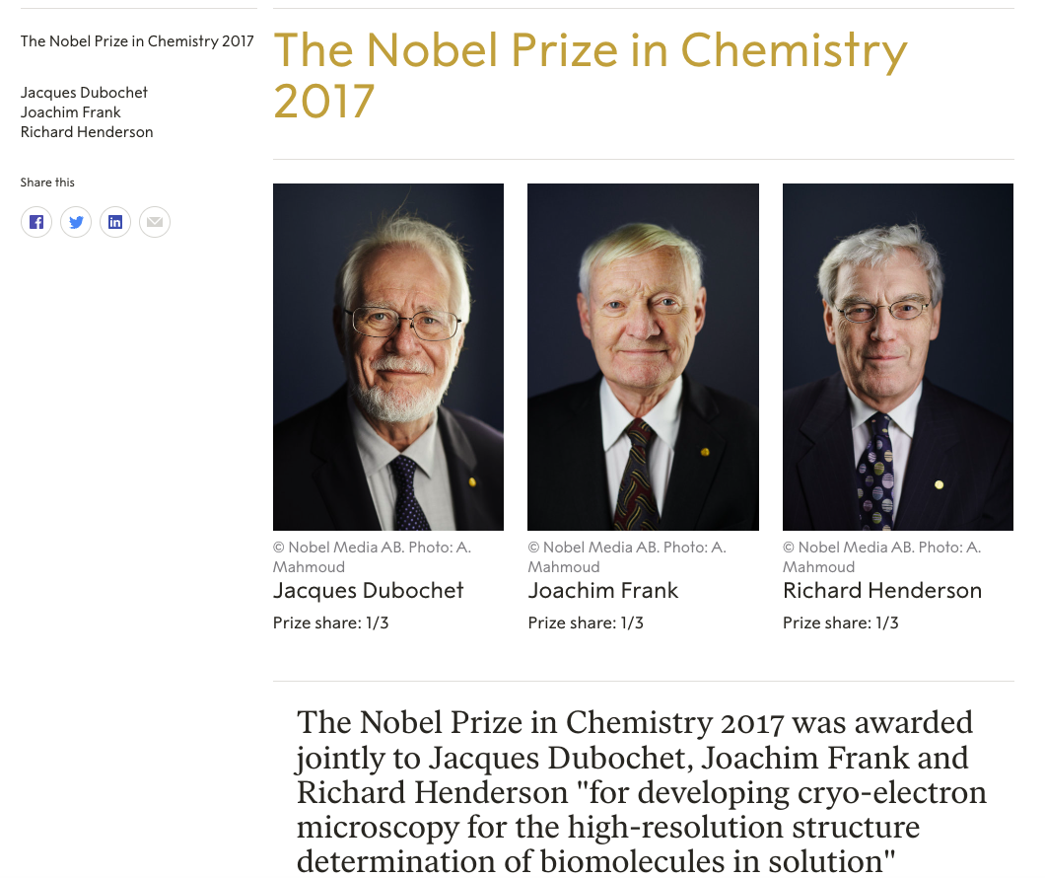

Slide 25
Benefits and Drawbacks
Benefits
Method of choice for large multicomponent complexes
Lower purity requirements; starting substance must be ~85% pure
Drawbacks
Frozen systems $≠$ physiological
Usually lower resolution
No hydrogen observed
https://cryoem.slac.stanford.edu/what-is-cryo-em

Slide 26
Review Question
1. Cryo-EM
2. X-Ray Crystallography
3. NMR
Which method uses electrons to form images of biological macromolecules at atomic resolution?
Which method analyzes non-zero nuclear spin interactions within a magnetic field?
Which method analyzes the angles and intensities of diffracted X-ray beams?
https://e7.pngegg.com/pngimages/503/822/png-clipart-folding-home-folding-funnel-protein-folding-energy-landscape-levinthal-s-paradox-brief-introduction.png

Slide 27
Review Discussion Questions
What are some of the benefits (positive aspects) and drawbacks
(negative aspects) of X-Ray Crystallography, NMR, and Cryo-EM?
Which structure determination method would be best for a large membrane-associated complex?
If you have a small, pure protein and you are interested its protonation states, which method for structural determination is most ideal?
https://e7.pngegg.com/pngimages/503/822/png-clipart-folding-home-folding-funnel-protein-folding-energy-landscape-levinthal-s-paradox-brief-introduction.png

